Slide 1
Design Patterns
Chapter 4

Slide 2
Decorator, Revisited
Look at this example?
class TextBase { public: virtual void output() = 0; }
class Quote2Text : public TextBase {
public:
Quote2Text() : tptr(nullptr) {}
void setTextObject(TextBase* t) { tptr(t); }
void output() {
if (tptr)
{ cout << “\””; tptr->output(); cout << “\””; } }
private:
TextBase* tptr;
}
What is the problem?

Slide 3
Decorator Initialization
Complete initialization of the Quote2Text decorator took two steps
If you forgot the second step, you have at best a meaningless object
(If you didn’t check in the output method, you might even crash the program)

Slide 4
Principle: RAII
Resource Acquisition Is Initialization
Whenever a resource is acquired, make sure it is initialized at the same time
(part 2 of RAII: object destruction includes appropriate cleanup)
For object acquisition (creation):
Constructors work well to ensure RAII
But there are limitations:

Slide 5
Object Creation Questions
How to ensure that the correct subclass gets created?
What if other things have to happen in conjunction with creation of an object?
What if you have to create two or more related objects?

Slide 6
Controlling Object Creation
Ultimately, the exact object of a type must be known in order to create it (duh)
Foo f;
Bar b = new Bar(“baz”);
But this violates an important principle:
Program to an interface, not an implementation
Or, program to abstractions, not concrete types
Concrete object creation is best localized in one place
So introducing new types doesn’t cause maintenance trauma

Slide 7
A C++-specific Creation Issue
C++ allows objects everywhere
Not just on the heap (new is not required)
Suppose we have a context that wants to force objects to be on the heap only
Example: 3370 Program 2 (Memory Pool)
How can we prevent non-heap object creation?

Slide 8
Static (single class) Creator
Provide a static method that returns a pointer to a heap object
Make all constructors non-public
(Visit Pool example from CS 3370)

Slide 9
Another Scenario
Suppose you need to serialize objects
And you don’t have such facilities on your platform
To de-serialize objects requires creating the correct type on-the-fly
Based on some data in the file entry for the object

Slide 10
Employee Hierarchy

Slide 11
Dependency Inversion Principle www.objectmentor.com/resources/articles/dip.pdf
High-level modules should not depend on low-level modules
Both should depend on abstractions
Abstractions should not depend on details
Details should depend on abstractions
Why?
So clients of abstractions are insulated from changes

Slide 12
Rules of Thumb for the DIP
No variable in an abstraction should hold a pointer to a concrete class
No class should derive from a concrete class
(a class shouldn’t be both abstract and concrete)
No method should override an implemented method of any of its base classes
Only override abstract methods
Avoid asking a class what type it is
You shouldn’t care
These rules can’t be followed all the time!
Emphasis on thumb :-)
The key is how volatile the lower-level module is

Slide 13

Note: What is an “Abstraction?”

Slide 14

Non- abstract (concrete) image
"Isola di s giorgio maggiore pano" by Mfield, Matthew Field, http://www.photography.mattfield.com - Own work. Licensed under CC BY-SA 3.0 via Commons - https://commons.wikimedia.org/wiki/File:Isola_di_s_giorgio_maggiore_pano.jpg#/media/File:Isola_di_s_giorgio_maggiore_pano.jpg

Slide 15
Abstraction in Code
Dealing in generalities
“The structured removal of information”
Often done by subclassing
The base class/interface is the abstraction
Subclasses/implementations are concrete
They have all the details
Code that uses base classes/interfaces is also abstract
And should follow the DIP

Slide 16
Parametric Factories
The type of object created depends on dynamic information
Either read from an input source or provided as a parameter to a factory method
The 1410 example has a major faux pas:
Employee::retrieve( ) knows about subclasses
Violates the DIP
Can’t always be avoided
But can be moved to a better place

Slide 17
N-tier Architecture

Slide 18
N-tier Architecture Critique
Appears to violate the DIP
This is solved by having high-level modules write to an abstraction of its lower-level service module
So implementation can vary and not disturb the high-level client
(See next slide)

Slide 19
Following the DIP

Slide 20

Factories
Allow a (client) higher-level module to defer the details of object creation to its (server) lower-level service module
Including determining the type of the object that needs to be created
“Polymorphic Factory”
"VW Wolfsburg" by User:High Contrast - Own work (taken by me). Licensed under CC BY 2.0 de via Commons - https://commons.wikimedia.org/wiki/File:VW_Wolfsburg.JPG#/media/File:VW_Wolfsburg.JPG

Slide 21
Another DIP Violation

Slide 22
A Better Shape Scenario

Slide 23
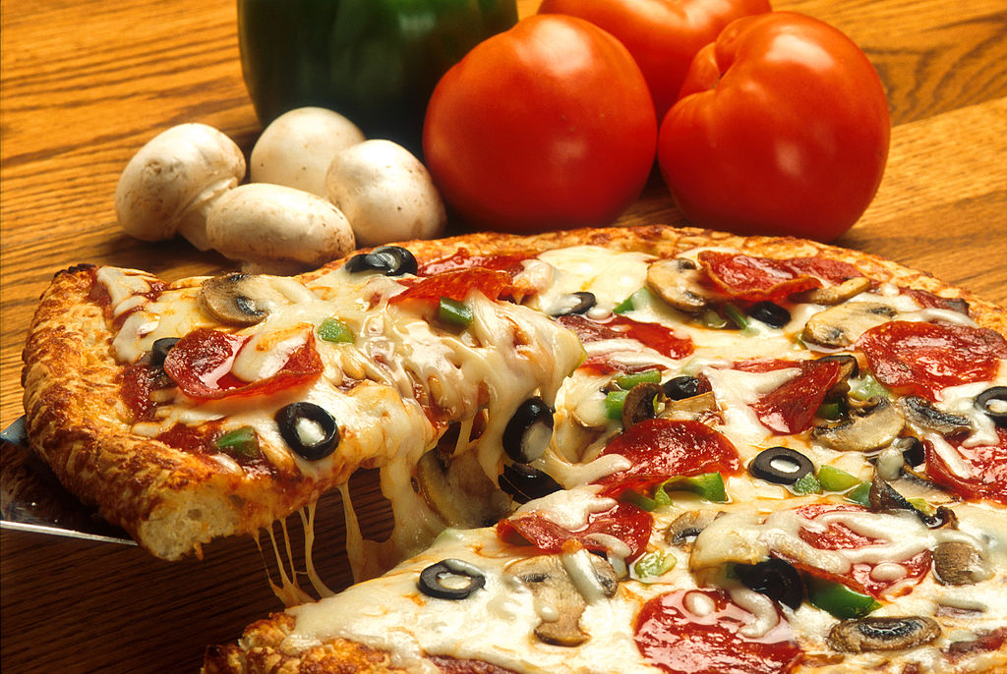
Pizza in Objectville
public Pizza orderPizza() {
Pizza pizza = new Pizza(); // 1 type only!
pizza.prepare();
pizza.bake();
pizza.cut();
pizza.box();
return pizza;
}
What if we want to make multiple types of pizza?

Slide 24
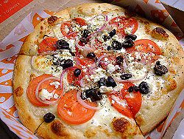
More Pizza in Objectville
public Pizza orderPizza(String type) {
Pizza pizza;
if (type.equals(“cheese”))
pizza = new CheesePizza();
else if (type.equals(“greek”))
pizza = new GreekPizza();
(etc.)
pizza.prepare();
pizza.bake();
pizza.cut();
pizza.box();
return pizza;
}

Slide 25
Here We Go Again!
As new pizza types arrive, we must change this code
If this is the only place it occurs, it’s not the end of the world
Nonetheless, let’s try to…
… Separate those things that vary from those that don’t (again)
And now that we know about Open-Closed:
Let’s try to make this code extensible while being closed to modification

Slide 26
A Pizza-Creating Class
public class SimplePizzaFactory {
public Pizza createPizza(String type) {
Pizza pizza = null;
if (type.equals("cheese")) {
pizza = new CheesePizza();
} else if (type.equals("pepperoni")) {
pizza = new PepperoniPizza();
} else if (type.equals("clam")) {
pizza = new ClamPizza();
} else if (type.equals("veggie")) {
pizza = new VeggiePizza();
}
return pizza;
}
}

Slide 27
Refactoring orderPizza( )
public class PizzaStore {
SimplePizzaFactory factory;
public PizzaStore(SimplePizzaFactory factory) {
this.factory = factory;
}
public Pizza orderPizza(String type) {
Pizza pizza = factory.createPizza(type);
pizza.prepare();
pizza.bake();
pizza.cut();
pizza.box();
return pizza;
}
}

Slide 28
What do you think?
We have pretty much just moved things around so far.
But it does keep creation all in one place
Have we totally hidden concrete class information?
Of course not. You can’t.
But depending on who calls orderPizza, we might do better.
The pizza type is a string passed in. Maybe we should encapsulate that too.

Slide 29
Refactoring orderPizza( )
public class PizzaStore {
SimplePizzaFactory factory;
public PizzaStore(SimplePizzaFactory factory) {
this.factory = factory;
}
public Pizza orderPizza(String type) {
Pizza pizza = factory.createPizza(type);
pizza.prepare();
pizza.bake();
pizza.cut();
pizza.box();
return pizza;
}
}
Maybe: Remove type from the function calls and let createPizza() ask the user for the type of pizza they want.

Slide 30
Revisiting Employee: The Simple Factory
We were uncomfortable with the switch-based factory inside the abstract Employee
Good call!
Move it out to its own class
EmployeeFactory
Thereby we separate object creation from object use (decoupling clients from future factory changes)
See next slide

Slide 31
A Better Employee Hierarchy
See code now…

Slide 32
A Variation on SimplePizzaFactory
We could just use a static method to return the correct type of Pizza:
SimplePizzaFactory.createPizza(String)
In any case, it should be available to other potential clients
PizzaShopMenu, for example
So it should be in its own class
So changes are isolated from clients
See page 117, 115 (no dumb questions)

Slide 33
Limitations of a Static Factory
You can’t override a static method
Therefore you can’t have polymorphic creation
But you can have parametric creation
(We’ll do both soon)
Take your Pick

Slide 34
And Now… Life Happens
There are different “styles” of pizza
A New York style Cheese differs from a Chicago style
Your business savvy says you should support both

Slide 35
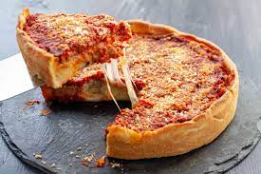
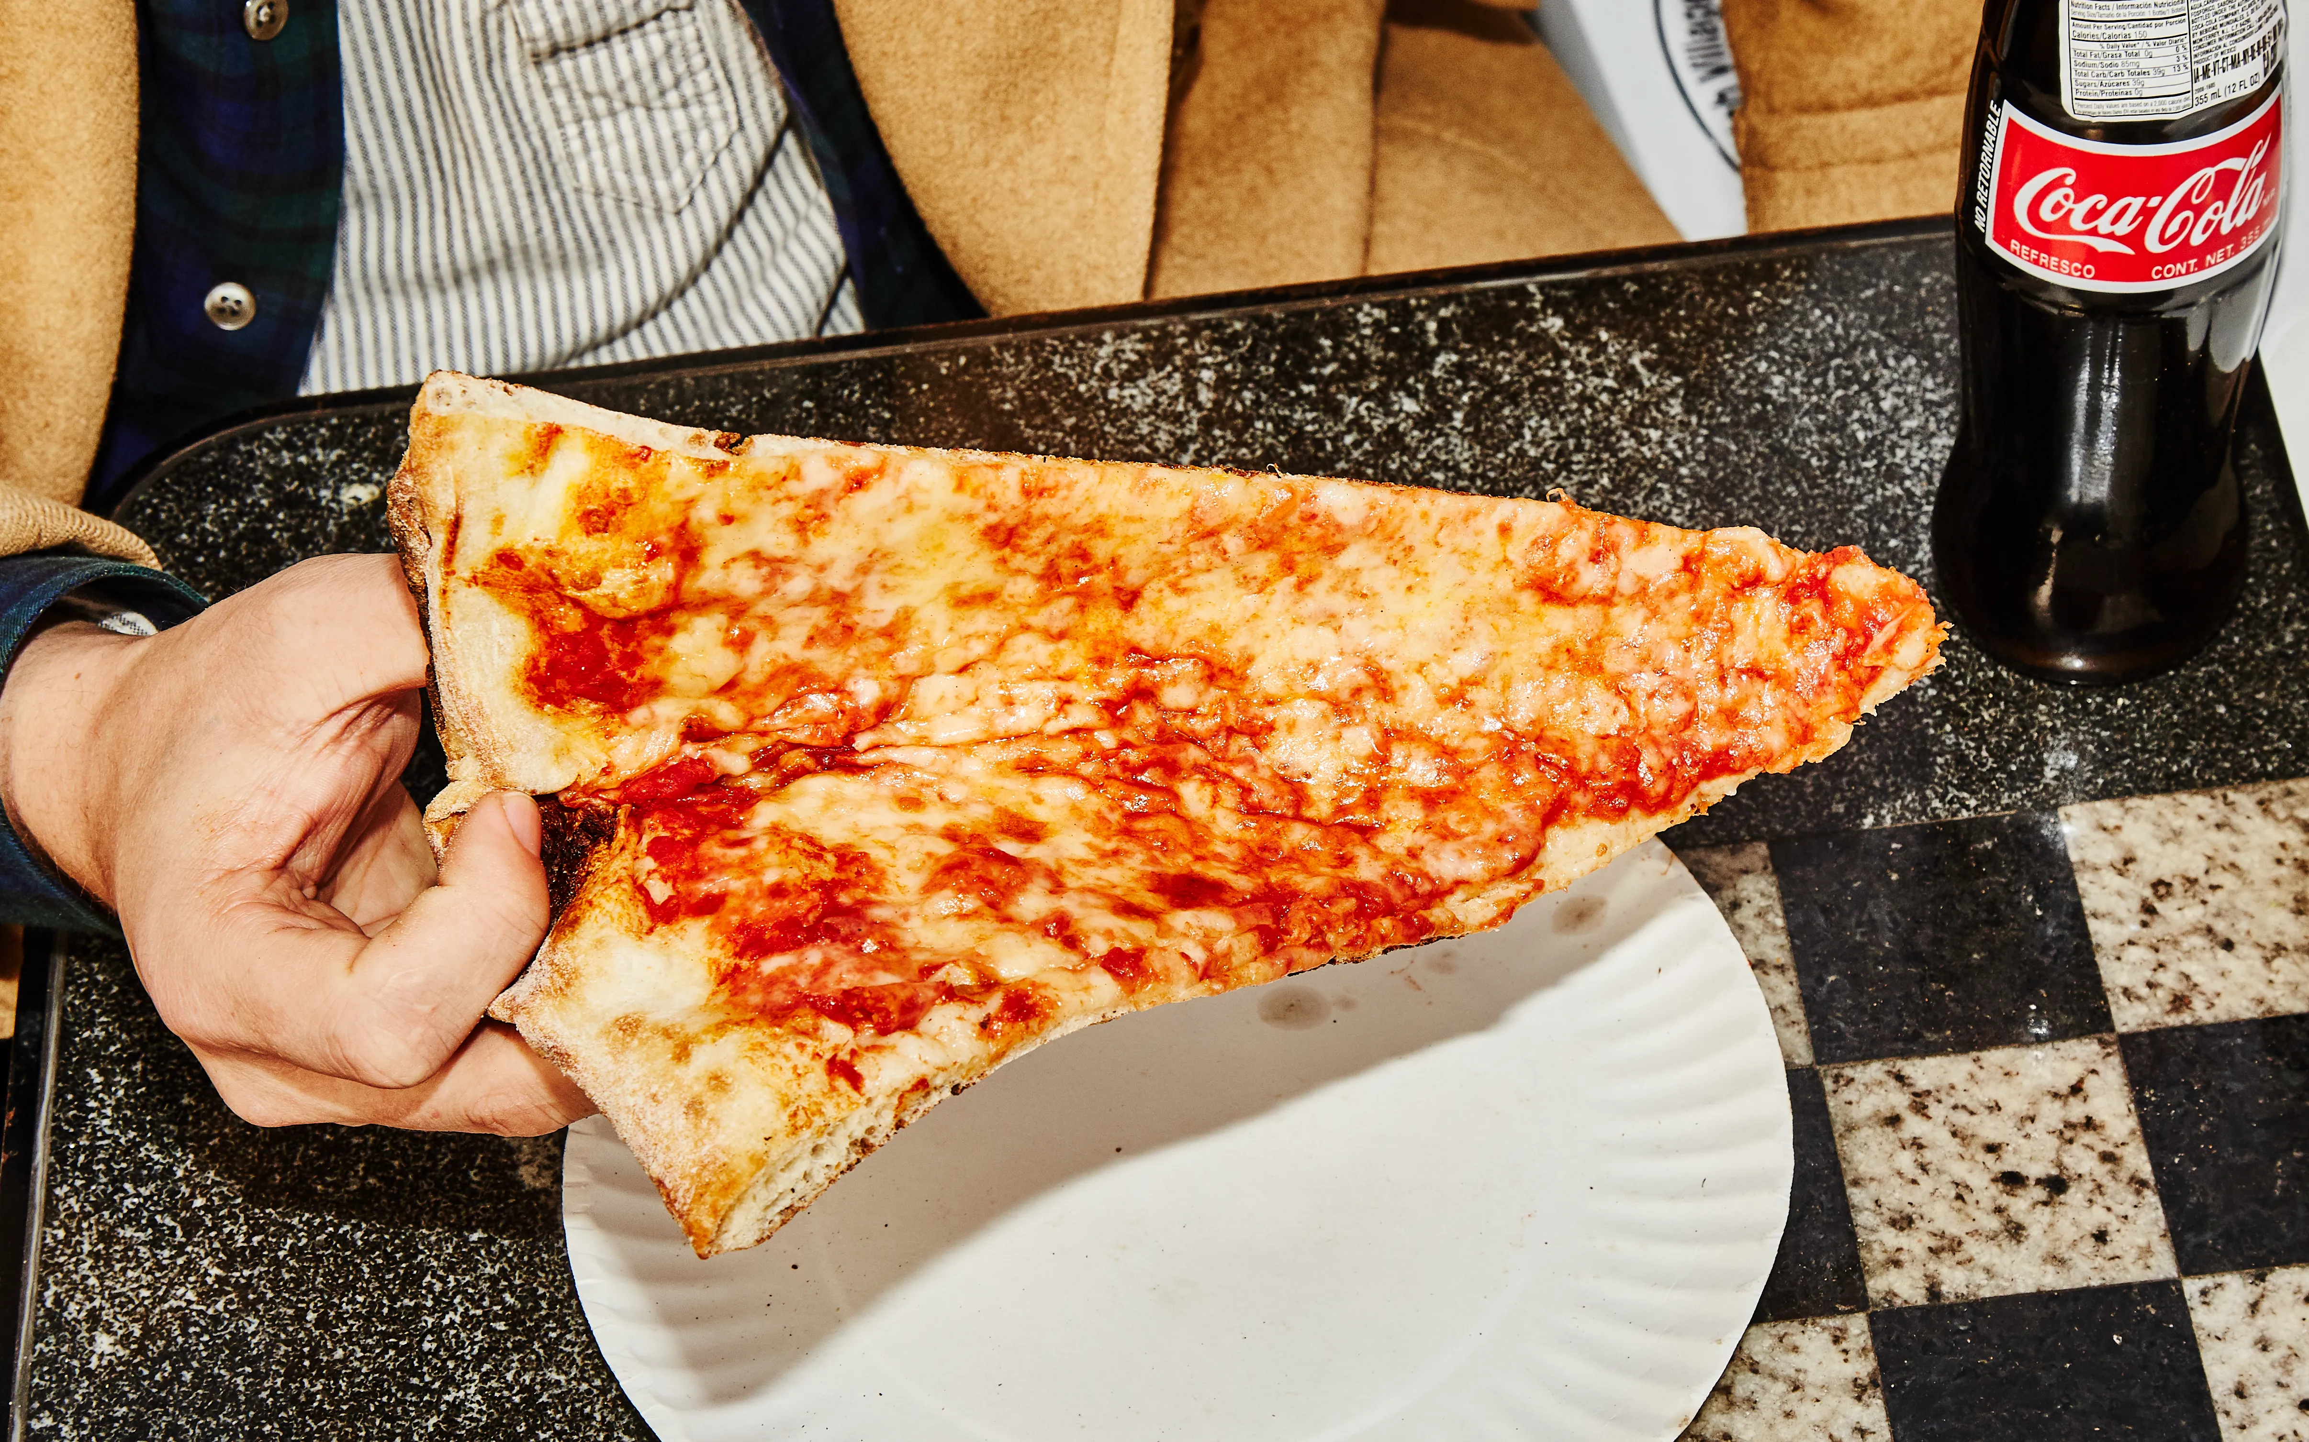
Which is best?
Chicago New York

Slide 36
One “solution” (see p. 137)
if (style == “New York”) {
if (type == “cheese”)
return new NewYorkCheesePizza();
else if (…)
…
}
else if (style == “Chicago”) {
if (type == “cheese”)
return new ChicagoCheesePizza();
else if (…)
…

Slide 37
Chapter 4. Baking with OO Goodness Page 29
Return to Table of Contents
WKH IDFWRU\ SDWWHUQ
) ^MZa LMXMVLMV\ 8QbbI;\WZM
6KDUSHQ \RXU SHQFLO
4M\¼[ XZM\MVL aW]¼^M VM^MZ PMIZL WN IV 77 NIK\WZa. 0MZM¼[ I ^MZ[QWV WN \PM 8QbbI;\WZM \PI\ LWM[V¼\ ][M I NIK\WZa# UISM I KW]V\ WN \PM V]UJMZ WN KWVKZM\M XQbbI WJRMK\[ \PQ[ KTI[[ Q[ LMXMVLMV\ WV. 1N aW] ILLML +ITQNWZVQI [\aTM XQbbI[ \W \PQ[ 8QbbI;\WZM, PW_ UIVa WJRMK\[ _W]TL Q\ JM LMXMVLMV\ WV \PMV'
SXEOLF FODVV 'HSHQGHQW3L]]D6WRUH ^
SXEOLF 3L]]D FUHDWH3L]]D(6WULQJ VW\OH, 6WULQJ W\SH) ^ 3L]]D SL]]D QXOO;
LI (VW\OH.HTXDOV(³1<´)) ^
LI (W\SH.HTXDOV(³FKHHVH´)) ^
SL]]D QHZ 1<6W\OH&KHHVH3L]]D();
` HOVH LI (W\SH.HTXDOV(³YHJJLH´)) ^ SL]]D QHZ 1<6W\OH9HJJLH3L]]D();
` HOVH LI (W\SH.HTXDOV(³FODP´)) ^ SL]]D QHZ 1<6W\OH&ODP3L]]D();
` HOVH LI (W\SH.HTXDOV(³SHSSHURQL´)) ^ SL]]D QHZ 1<6W\OH3HSSHURQL3L]]D();
`
` HOVH LI (VW\OH.HTXDOV(³&KLFDJR´)) ^ LI (W\SH.HTXDOV(³FKHHVH´)) ^
SL]]D QHZ &KLFDJR6W\OH&KHHVH3L]]D();
` HOVH LI (W\SH.HTXDOV(³YHJJLH´)) ^
SL]]D QHZ &KLFDJR6W\OH9HJJLH3L]]D();
` HOVH LI (W\SH.HTXDOV(³FODP´)) ^
SL]]D QHZ &KLFDJR6W\OH&ODP3L]]D();
` HOVH LI (W\SH.HTXDOV(³SHSSHURQL´)) ^
SL]]D QHZ &KLFDJR6W\OH3HSSHURQL3L]]D();
`
` HOVH ^
6\VWHP.RXW.SULQWOQ(³(UURU: LQYDOLG W\SH RI SL]]D´); UHWXUQ QXOO;
` SL]]D.SUHSDUH();
SL]]D.EDNH();
SL]]D.FXW();
SL]]D.ER[();
UHWXUQ SL]]D;
`
`
<RX FDQ ZULWH
\RXU DQVZHUV KHUH
\RX DUH KHUH ► 137
+DQGOHV DOO WKH 1<
VW\OH SL]]DV
+DQGOHV DOO WKH
&KLFDJR VW\OH
SL]]DV
QXPEHU
QXPEHU ZLWK &DOLIRUQLD WRR
Chapter 4. Baking with OO Goodness
Head First Design Patterns By Eric Freeman, Elisabeth Freeman, Bert Bates, Kathy Sierra ISBN: 0596007124 Publisher: O'Reilly
Print Publication Date: 2004/10/25
Prepared for Ann Cherkis, Safari ID: maottw@gmail.com
written permission for reprints and excerpts from the publisher. Redistribution or other use that violates the fair use priviledge under U.S. copyright laws (see 17 USC107) or that otherwise violates the Safari Terms of Service is strictly prohibited.
www.it-ebooks.info

Slide 38
Don’t Repeat Yourself!
We’re cutting and pasting code again
Stop it!
Create different types of factories instead
One for each style
But they of course implement a common interface
Where should the factories reside?
That is, how shall they be called polymorphically?

Slide 39
A Polymorphic Factory
The correct createPizza( ) is called by polymorphism.

Slide 40
P 125

Slide 41
Using the Factory Method
public abstract class PizzaStore {
protected abstract Pizza createPizza(String type);
public Pizza orderPizza(String type) {
Pizza pizza = createPizza(type);
pizza.prepare();
pizza.bake();
pizza.cut();
pizza.box();
return pizza;
}
}

Slide 42
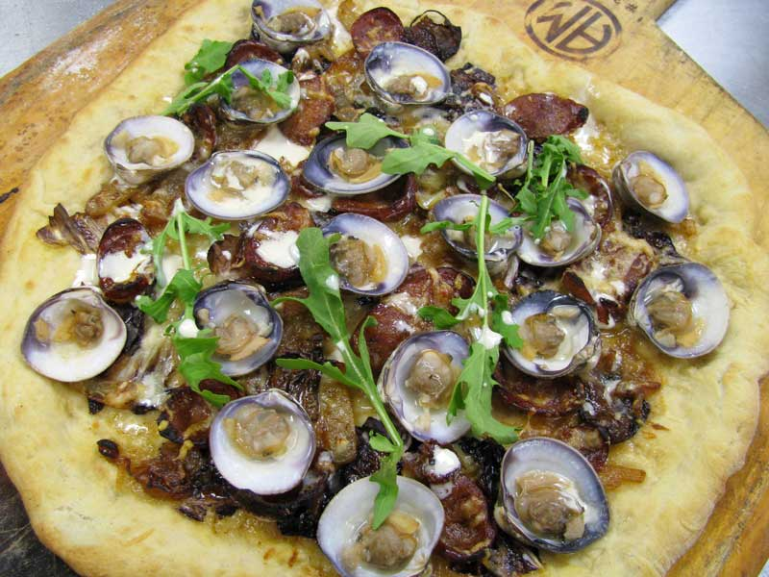
But Not Much Change Here
public class NYPizzaStore extends PizzaStore {
Pizza createPizza(String item) {
if (item.equals("cheese")) {
return new NYStyleCheesePizza();
} else if (item.equals("veggie")) {
return new NYStyleVeggiePizza();
} else if (item.equals("clam")) {
return new NYStyleClamPizza();
} else if (item.equals("pepperoni")) {
return new NYStylePepperoniPizza();
} else return null;
}
}
That’s the breaks with polymorphic factories. It allows us to vary the concrete Pizza type in one place, however.

Slide 43
Factory Method Creational
Intent:
Lets a class defer object instantiation to subclasses.
Context:
A module uses an abstraction, so you want to follow the DIP and not depend on concrete details. The client module may not even know which class to instantiate.
Solution:
Define an interface for creating a family of objects, but let subclasses decide which class to instantiate.

Slide 44
Factory Method Class Sketch

Slide 45
Parallel Hierarchies
A hierarchy for the products
A hierarchy for the creators
With a polymorphic factory method
See page 131, 132, 134
See also p. 135

Slide 46
Recap: Dependency Inversion Principle
How does the Factory Method relate to the DIP?
See page 140
(see also p. 141, 143)

Slide 47
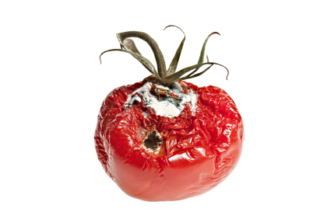
More Changes Afoot
Franchisees have been using inferior ingredients
Infidels!
So you want more control over how pizzas get made
While still allowing for stylistic differences
So we’re drilling down a little deeper to how pizzas are actually made

Slide 48
Controlling Ingredients
Pizza ingredients come in families:
Sauce, cheese, dough, toppings
They all have these components (p. 145)
But with differences (e.g., parmesan vs. mozzarella)
You want to ship ingredients together
So we need a factory to build families of ingredients
Note: my diagrams differ from the book’s
They’re better!

Slide 49
PizzaIngredientFactory
Will have a factory method for each ingredient type
createDough, createSauce, etc.
These will be specialized in concrete subclasses by region
NYPizzaIngredientFactory, etc.
So we’re talking families of factory methods

Slide 50
The Ingredient Factories

Slide 51
Refactoring Pizza
Pizza needs to collect the right kind of ingredients
We’ll just put this into the prepare method
But we’ll make it abstract so subclasses can override it
(This actually isn’t totally necessary, as you’ll see. It could just be implemented in Pizza)
What is necessary is that the correct ingredients are obtained

Slide 52
Getting the Right Ingredients
Somewhere (in prepare for now) we say:
sauce = ingredientFactory.createSauce( );
cheese = ingredientFactory.createCheese( );
etc.
These are fields in Pizza
Before we just had a list called toppings
Now we’re taking over what those toppings are

Slide 53
The Pizza Hierarchy No more NYCheesePizza, ChicagoCheesePizza…

Slide 54
What about PizzaStore?
This is what establishes the ingredientFactory
And passes it to the pizza it creates with its (independent) Factory Method

Slide 55
The PizzaStore Hierarchy

Slide 56
NYPizzaStore Setting up A parametric abstract factory
public class NYPizzaStore : extends PizzaStore {
PizzaIngredientFactory ingredientFactory;
public NYPizzaStore() {
ingredientFactory = new NYPizzaIngredientFactory();
}
…

Slide 57
NYPizzaStore.createPizza( ) A parametric method in our Abstract Factory
protected Pizza createPizza(String item) {
Pizza pizza = null;
if (item.equals("cheese")) {
pizza = new CheesePizza(ingredientFactory);
pizza.setName("New York Style Cheese Pizza");
} else if (item.equals("veggie")) {
pizza = new VeggiePizza(ingredientFactory);
pizza.setName("New York Style Veggie Pizza");
} else if (item.equals("clam")) {
pizza = new ClamPizza(ingredientFactory);
pizza.setName("New York Style Clam Pizza");
} else if (item.equals("pepperoni")) {
pizza = new PepperoniPizza(ingredientFactory);
pizza.setName("New York Style Pepperoni Pizza");
}
return pizza;
}

Slide 58
The Process
createPizza passes the correct ingredientFactory to CheesePizza
(see p. 150-151)

Slide 59
Abstract Factory Creational
Intent:
Provide an interface for creating families of related or dependent objects without specifying their concrete classes.
Context:
Your system needs to be configured with one of multiple families of products, but it should be independent of how its products are created and assembled.
Solution:
Declare an abstract type with methods for creating each type of component. Subclasses create the correct concrete types for the family they represent.

Slide 60
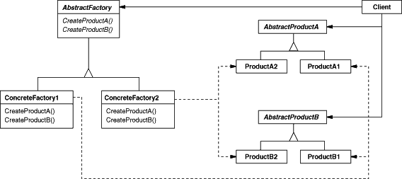
Abstract Factory Class Sketch

Slide 61
Factory Method vs. Abstract Factory
Factory Method creates a single object
It can decay into a single static method
The abstract root often has a processing method that calls the factory method
i.e., the factory method is in the key abstraction the client uses
Abstract Factory creates families of related objects
It requires multiple polymorphic methods
Therefore clients must use a factory object
See pages 156-157, 160-161, 158-159

Slide 62
Disposal Methods
It is often necessary to destroy objects
Especially if they own resources other than memory
In some cases:
Just letting the garbage collector do its job isn’t sufficient (e.g., you have to explicitly release a resource)
Calling, the object’s destructor isn’t enough, or leads to excess coupling (e.g., you have destroy calls in several places.)

Slide 63
Disposal Methods
Provide disposal methods that encapsulate details of object disposal
Mirror of Factory Method
Can have a static destroy
Can have a polymorphic destroy
Can have an “automatic” destroy in C++
RAII – uses destructors
shared_ptr: a pointer proxy that deletes its data
Members of abstract factories can have corresponding disposal methods

Slide 64
Complex Factory: Builder
Some objects are complex enough that they can’t be created in a single atomic step.
Stepwise creation
Often separated by time
May be different each time
Usually involves different sub-objects

Slide 65
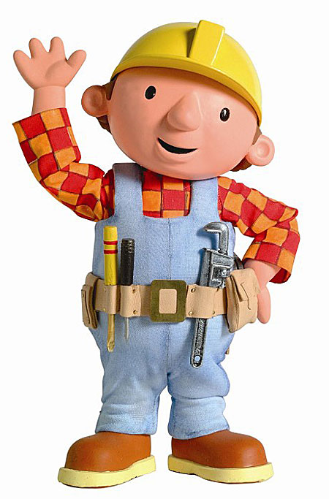
Builder
Therefore, use a Builder object that manages the creation of the object:
Provides methods for creating (and maybe disposing) the parts
May return the completed complex object
By Source (WP:NFCC#4), Fair use, https://en.wikipedia.org/w/index.php?curid=37342560

Slide 66
What Factories Accomplish
They separate the creation of objects from their use
This minimizes coupling between clients and abstractions

Slide 67
Summary of Factories
Simple Factory: a single function to create the proper type of object – usually parametric
Simple hierarchy – the most common approach
A Simple Factory may be Static (but Static Factory isn’t its own pattern)
Factory Method: a hierarchy of methods to create the proper type of object
Used when there are two dimensions of variability that determine object type (e.g., pizza type and style)
Abstract Factory: a hierarchy to create families of objects
May create sets of (related) factory methods
Builder: an object to manage non-atomic creation of a complex object or objects

Slide 68
Principles Summary
RAII: Resource Acquisition Is Initialization
DIP: Dependency Inversion Principle
Concrete details depend on Abstractions, not the other way around

